Slide 1
Custom views
Advanced Android Development
Lesson 10

Slide 2

10.1 Custom views
Extending or replacing a View

Slide 3
Contents
Overview of custom views
Creating a custom view class
Drawing the custom view
Using the custom view in a layout
Using custom attributes

Slide 4
Overview of custom views

Slide 5
View and View subclasses
View class is the basic building block of a UI
Use View subclasses (EditText, Button, etc.) to enable user interaction and display information
Extend View or any View subclass to customize appearance and behavior, including user interaction

Slide 6
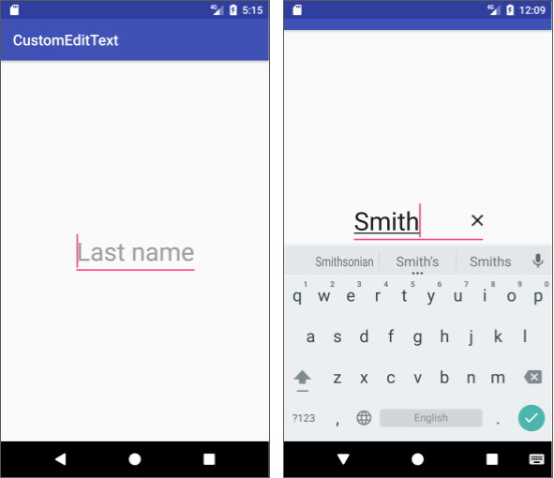
Custom view to extend a View subclass
Inherit and customize the look and behavior of the subclass
Example:
EditText for entering text
Extended EditText with a reset (X) button to clear text

Slide 7
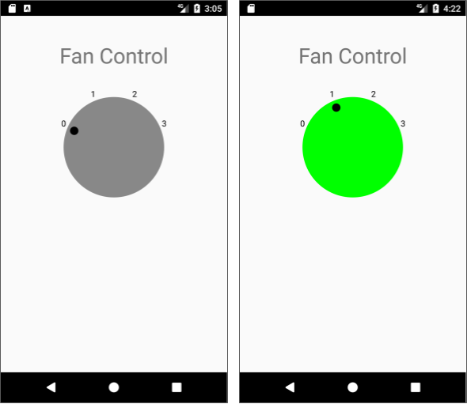
Custom view to extend View itself
Draw any shape or size
Create your own interactive elements and behavior

Slide 8
Steps for creating custom views
Create a class that extends View or a View subclass
Override View methods
Extending View: Draw entire view by overriding onDraw()
Extending a View subclass: Override behavior or appearance
Use the custom view class in a layout

Slide 9
Creating a custom view class

Slide 10
Create a custom view class
Create a new Java class in Android Studio
Choose a superclass:
To extend View, choose android.view.View
To extend a View subclass, choose subclass (Button, EditText, etc.)

Slide 11
Implement required constructors
EditText example:
AppCompatEditText(context:Context) Creates instance of View
AppCompatEditText(context:Context, attrs:AttributeSet) Inflates view from an XML layout and applies XML attributes
AppCompatEditText(context:Context, attrs:AttributeSet, defStyleAttr:int) Applies a default style and attributes

Slide 12
Create the initialize helper method
private void init() {
// Define member variable for drawable.
mClearButtonImage = ResourcesCompat
.getDrawable(getResources(),
R.drawable.ic_clear_opaque_24dp, null);
// If the X (clear) button is tapped, clear the text.
// If the text changes, show or hide the X (clear) button.
}

Slide 13
Call helper method from constructors
public CustomViewExample(Context context) {
super(context);
init();
}
public CustomViewExample(Context context, AttributeSet attrs) {
super(context, attrs);
init();
}

Slide 14
Drawing a custom view

Slide 15


Extend a subclass to use its appearance
No need for code to draw or redraw
Extended subclass inherits look and behavior of subclass
Example: Extend an EditText
Override EditText subclass methods to customize appearance (add an X)

Slide 16
Customize extended EditText (1)
Override EditText subclass methods:
Use setCompoundDrawables() and getCompoundDrawables() inherited from TextView to set and retrieve drawables in custom view
Use setCompoundDrawablesRelativeWithIntrinsicBounds() to accommodate RTL and LTR languages

Slide 17

Customize extended EditText (2)
Setting a drawable for the extended EditText
At start: left side for LTR, right side for RTL
At end: right side for LTR, left side for RTL
Use null for no drawable at that position
setCompoundDrawablesRelativeWithIntrinsicBounds
(null, // Start of text
null, // Above text
mClearButtonImage, // End of text
null); // Below text

Slide 18
Draw an extended View
Override onDraw() using Canvas styled by Paint
Override onSizeChanged() to calculate view's size when it first appears and when it changes
Use invalidate() when responding to click, to force a redraw by forcing a call to onDraw()
Override onMeasure() to define custom view in view hierarchy

Slide 19
Canvas and Paint drawing methods
Draw text with drawText()
Typeface with setTypeface()
Text color with setColor()
Draw shapes using drawRect(), drawOval(), and drawArc()
Shape fill and outline with setStyle()
Draw bitmaps using drawBitmap()

Slide 20
Examples of drawing methods
Example using drawCircle() and drawText()
@Override
protected void onDraw(Canvas canvas) {
super.onDraw(canvas);
// Draw the dial.
canvas.drawCircle(mWidth / 2, mHeight / 2, mRadius, mDialPaint);
// Draw the text labels.
canvas.drawText(Integer.toString(i), x, y, mTextPaint);
// ...
}

Slide 21
Calculate the size
Calculate the size in onSizeChanged()
Called when custom view first appears and when it changes size
@Override
protected void onSizeChanged(int w, int h, int oldw, int oldh) {
// Calculate the radius from the width and height.
mWidth = w;
mHeight = h;
mRadius = (float) (Math.min(mWidth, mHeight) / 2 * 0.8);
}

Slide 22
Redraw after user interaction
Force a redraw after user interaction:
Add event listener such as onClick() from View.OnClickListener
When change occurs, use invalidate() to force call to onDraw()

Slide 23
Redraw after user interaction (example)
Example using View.OnClickListener:
setOnClickListener(new OnClickListener() {
@Override
public void onClick(View v) {
// On user click, perform actions.
// Redraw the view.
invalidate();
}
});

Slide 24
Using the custom view in a layout

Slide 25
Add the custom view to the UI
Add to activity's XML layout
Control appearance with inherited subclass attributes
If extending View, use View attributes
If extending a View subclass, use relevant attributes: For EditText subclass, use EditText attributes For ImageView subclass, use ImageView attributes...
Optional: Add custom attributes and set/get methods

Slide 26
Use View attributes
Example: XML attributes for extended View class
<com.example.customfancontroller.DialView
android:id="@+id/dialView"
android:layout_width="@dimen/dial_width"
android:layout_height="@dimen/dial_height"
android:layout_marginTop="@dimen/standard_margin"
android:layout_marginRight="@dimen/standard_margin"
<!-- More attributes ... -->
/>

Slide 27
Use View subclass attributes
Example: XML attributes for custom EditText
<com.example.android.customedittext.EditTextWithClear
android:layout_width="wrap_content"
android:layout_height="wrap_content"
android:inputType="textCapSentences"
android:textAppearance=
"@style/Base.TextAppearance.AppCompat.Display1"
android:hint="@string/last_name"
<!-- More attributes ... -->
/>

Slide 28
Creating custom attributes

Slide 29
Create custom attributes
Define an attribute and its type in XML
Set the attribute value
Retrieve the attribute value in the view's constructor

Slide 30
Declare custom view as styleable
Define name and type in <declare-styleable> resource in res/values/attrs.xml
Example: Attributes for "fan on" and "fan off" colors:
<resources>
<declare-styleable name="DialView">
<attr name="fanOnColor" format="reference|color" />
<attr name="fanOffColor" format="reference|color" />
</declare-styleable>
</resources>

Slide 31
Add custom attributes to XML layout
Specify values for custom attributes in XML layout
<com.example.customfancontroller.DialView
android:id="@+id/dialView"
app:fanOffColor="@color/yellow1"
app:fanOnColor="@color/cyan1"
<!-- More attributes ... -->
/>

Slide 32
Get custom attributes in view constructor
Attributes from resource bundle are passed to view's constructor
Use obtainStyledAttributes() to get a TypedArray of attribute values
public DialView(Context context, AttributeSet attrs) {
super(context, attrs);
TypedArray typedArray = context.obtainStyledAttributes
(attrs, R.styleable.DialView, 0, 0);

Slide 33
Get custom attributes from TypedArray
Use "getter" method depending on attribute type
getBoolean(), getString(), getColor() and more
Specify attribute as: R.styleable.ViewName_customAttributeName
// Get colors from the attributes
mFanOnColor = typedArray.getColor( R.styleable.DialView_fanOnColor, defaultFanOnColor);

Slide 34
Recycle TypedArray
TypedArray is a shared resource so recycle it after use
typedArray.recycle();

Slide 35
Example: Get attributes for fan colors
// Default colors in case attributes are not found
int defaultFanOnColor = Color.CYAN;
int defaultFanOffColor = Color.GRAY;
// Get colors for fan on and fan off from the attributes
mFanOnColor = typedArray.getColor( R.styleable.DialView_fanOnColor, defaultFanOnColor);
mFanOffColor = typedArray.getColor( R.styleable.DialView_fanOffColor, defaultFanOffColor);
// Recycle the typedArray
typedArray.recycle();

Slide 36
Use custom attributes in the view
Use retrieved attribute values in custom view
if (fanSelection >= 1) {
// fan is on
mDialPaint.setColor(mFanOnColor);
} else {
// fan is off
mDialPaint.setColor(mFanOffColor);
}

Slide 37
Use get/set with custom attributes
Attributes are read-only when view is initialized
For dynamic behavior, create "setter" and "getter" methods for each custom attribute
Example:
App allows user to change "fan off" and "fan on colors"

Slide 38
Example: Setter and getter for attribute
// Setter and getter for "fan on" color
public int getFanOnColor () {
return mFanOnColor;
}
public void setFanOnColor(int color) {
mFanOnColor = color;
}

Slide 39
Example: Change attributes dynamically
Example: App allows user to change the color of the fan controller
// Get the color that the user set
int newFanOnColor = getColorFromUser(...);
setFanOnColor(newFanOnColor);

Slide 40
Redraw after property changes
Use invalidate() after any change to properties
If change affects size or shape, use requestLayout()
Always make invalidate() and requestLayout() calls from UI thread

Slide 41
What's next?
Concept chapter: 10.1 Custom views
Practicals:
10.1A Creating a custom view from a View subclass
10.1B Creating a custom view from scratch

Slide 42
END

